Slide 1
Memory
Er. Sahit Baral may 18/2022

Slide 2
3. Memory [5 Hrs.]
3 Memory
3.1 Introduction
3.2 Memory Write Ability and Storage Permanence
3.3 Types of Memory
3.4 Composing Memory
3.5 Memory Hierarchy and Cache

Slide 3
Introduction
Any embedded system’s functionality consists of three aspects: processing, storage, and communication.
Processing is the transformation of data,
storage is the retention of data for later use, and
communication is the transfer of data.
We use processors to implement processing, memories to implement storage, and buses to implement communication.
Information can be program instruction or data for computational purposes
Instructions represent the group of bits of operation code along with operands, while data indicates the values of operand that will be used in the operation
In general, the instructions are stored in a type of memory which we refer as read only memory. And the data for regular computation are temporarily stored in registers

Slide 4
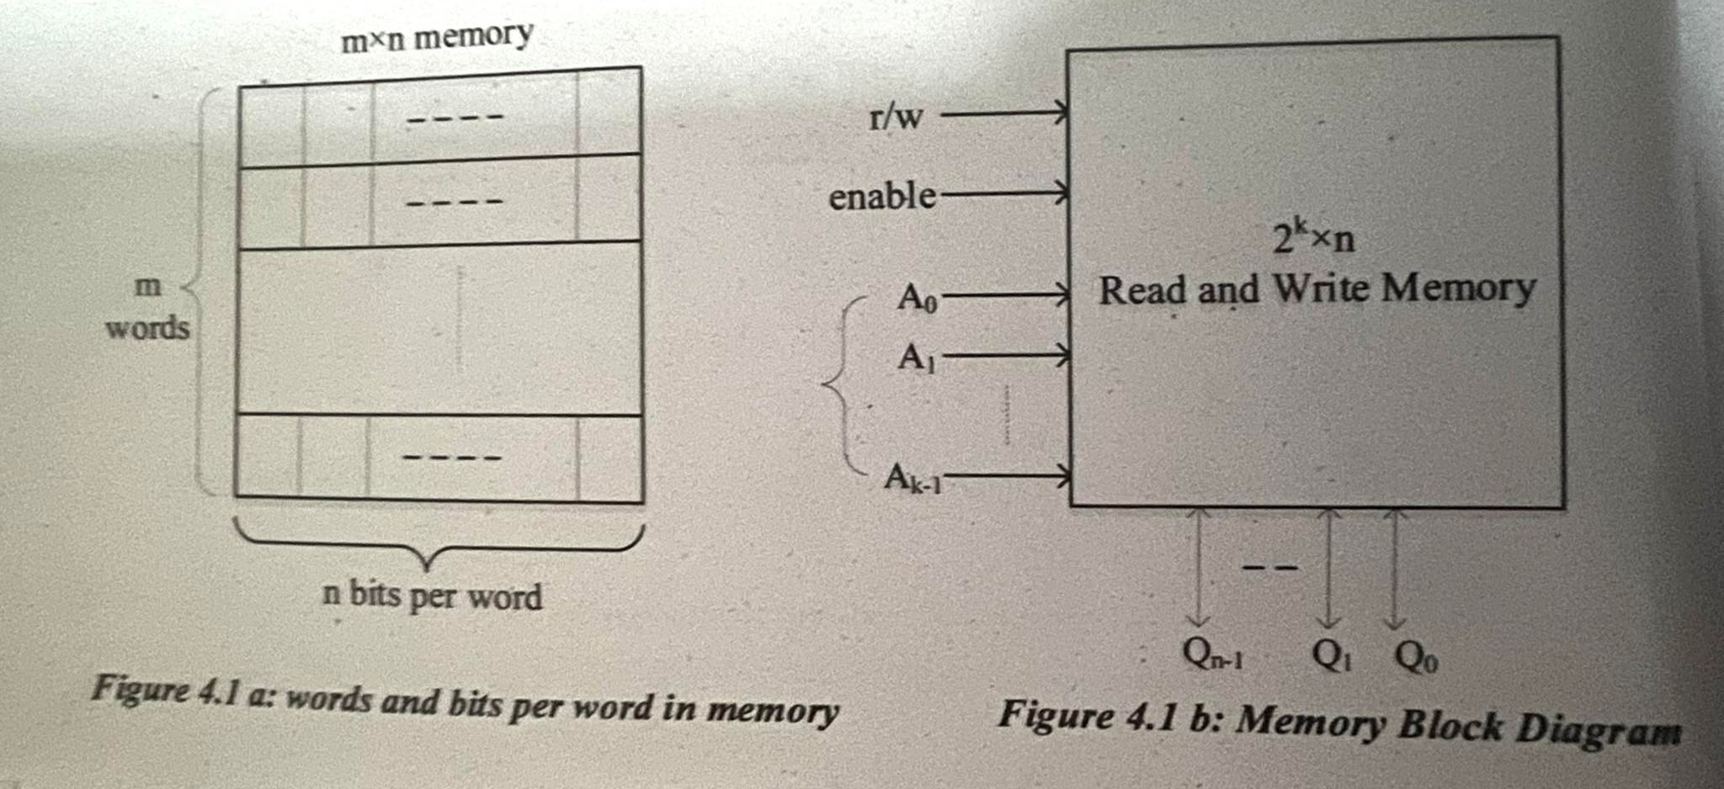
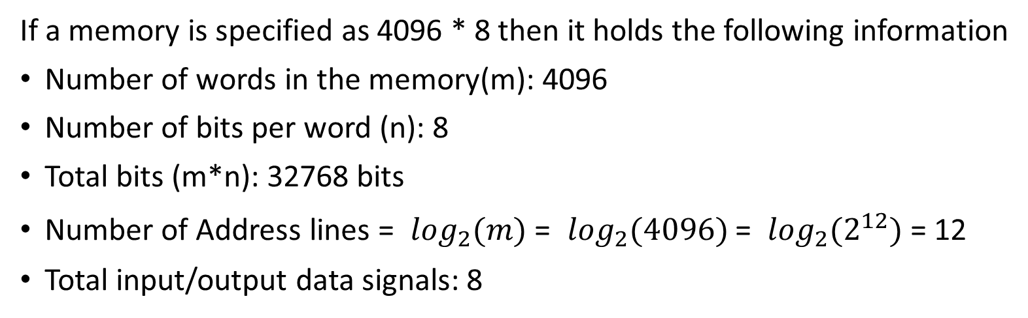
Introduction

Slide 5
Write Ability:
Write ability refers to the manner and speed that a particular memory can be written.
It also can be used to represent the number of times a memory can be programmed or written into.
In-system programmable is used to categorize memories into two along the write ability axis.
In-system programmable memory can be programmed by a processor where as non in-system programmable memory must be programmed by some external means.

Slide 6
Write Ability:
Range of write ability:
High End
Processor can write to memory simply and quickly by setting its address lines, data input bits and control lines appropriately. Example: RAM
Middle Range
Processor can write to memory a bit slower compared to high end. Example: EEPROM, FLASH
Lower Range
Special device called programmer is used to write into the memory. The device must apply suitable voltage levels to write to the memory. E.g.: EPROM, OTP ROM
Low End
Bits are stored only once during fabrication. Example: Mask-programmed ROM

Slide 7
Storage Permanence:
Storage permanence refers to the ability of memory to hold its stored bits after those bits have been written.
Volatile and Nonvolatile attributes are commonly used to divide memory types into two categories along the storage permanence axis.
The nonvolatile memory can hold its bits even after power is no longer supplied.
On the contrary, volatile memory requires continual power to retain its data.

Slide 8
Storage Permanence:
Range of storage permanence:
Low End
Memory in this range begins to lose its bits almost immediately after those bits are written and therefore it must be refreshed periodically. Example: DRAM
Lower Range
Memory holds bit as long as power is applied to the memory. Example: SRAM
Middle Range
Memory in this range holds bits for days, months, or even years after the memory power source has been turned off.
Example: NVRAM (non-volatile random-access memory)
High End
Memory in this end will never lose its bits, as long as the memory chip is not damaged. Example: Mask Programmed ROM

Slide 9
Types of Memory:
ROM: “Read-Only” Memory
Nonvolatile memory
Can be read from but not written to, by a processor in an embedded system
Traditionally written to, “programmed”, before inserting to embedded system
Uses
Store software program for general-purpose processor
Program instructions can be one or more ROM words
Store constant data needed by system
Implement combinational circuit
External view
enable
2^{k} × n ROM
A₀
…
^{A}k-1
…
^{Q}n-1
Q₀

Slide 10
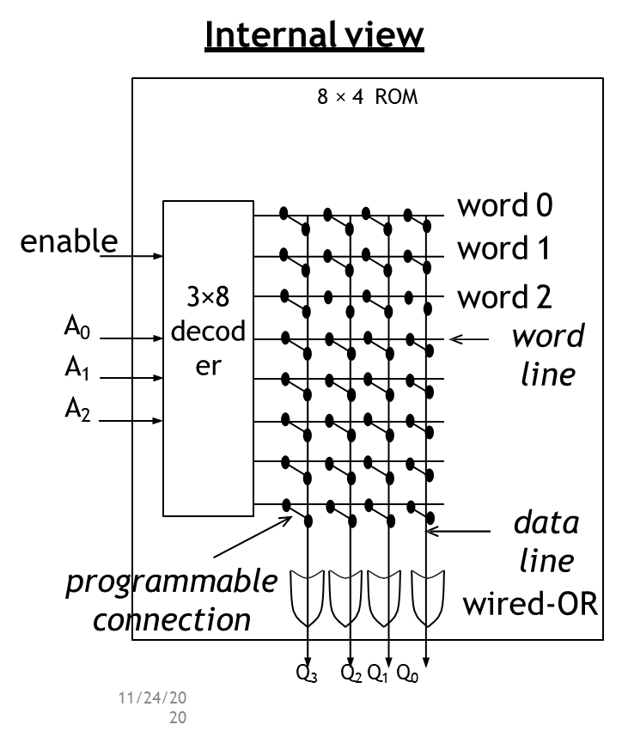
ROM: “Read-Only” Memory
Horizontal lines = words
Vertical lines = data
Lines connected only at circles
Decoder sets word 2’s line to 1 if address input is 010
Data lines Q3 and Q1 are set to 1 because there is a “programmed” connection with word 2’s line
Word 2 is not connected with data lines Q2 and Q0
Output is 1010

Slide 11
ROM: “Read-Only” Memory
1. Mask-programmed ROM
◆ Connections “programmed” at fabrication
◆ set of masks
◆ Lowest write ability
◆ only once
◆ Highest storage permanence
◆ bits never change unless damaged
◆ Typically used for final design of high-volume systems

Slide 12
ROM: “Read-Only” Memory
2. OTP ROM: One-time programmable ROM
◆ Connections “programmed” after manufacture by user
◆ user provides file of desired contents of ROM
◆ file input to machine called ROM programmer
◆ each programmable connection is a fuse
◆ ROM programmer blows fuses where connections should not exist
◆ Very low write ability
◆ typically written only once and requires ROM programmer device
◆ Very high storage permanence
◆ bits don’t change unless reconnected to programmer
◆ Commonly used in final products
◆ cheaper, harder to modify

Slide 13

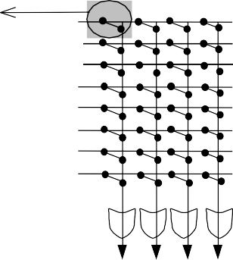






ROM: “Read-Only” Memory
3. EPROM: Erasable programmable ROM
Transistor has “floating” gate surrounded by an insulator
(a) Negative charges form a channel between source and drain storing a logic 1
(b) Large positive voltage at gate causes negative charges to move out of channel and get trapped in floating gate storing a logic 0
(c) (Erase) Shining UV rays on surface of floating-gate causes negative charges to return to channel from floating gate restoring the logic 1
(d) An EPROM package showing quartz window through which UV light can pass
0V
floating gate
source
drain
(a)
+15V
(b)
source
drain
5-30 min
source
drain
(c)
(d)

Slide 14
ROM: “Read-Only” Memory
3. EPROM: Erasable programmable ROM
◆ Better write ability
◆ can be erased and reprogrammed
thousands of times
◆ Reduced storage permanence
◆ program lasts about 10 years but is susceptible to radiation and electric noise
◆ Typically used during design development

Slide 15
ROM: “Read-Only” Memory
4. EEPROM: Electrically Erasable programmable ROM
Programmed and erased electronically
◆ typically by using higher than normal voltage
◆ can program and erase individual words
◆ Better write ability
◆ can be in-system programmable with built-in circuit to provide higher than normal voltage
◆ built-in memory controller commonly used to hide details from memory user
◆ writes very slow due to erasing and programming
◆ “busy” pin indicates to processor EEPROM still writing
◆ can be erased and programmed tens of thousands of times
◆ storage permanence to EEPROM (about 10 years)

Slide 16
ROM: “Read-Only” Memory
5. Flash memory
◆ Extension of EEPROM
◆ Same floating gate principle
◆ Same write ability and storage permanence
◆ Fast erase
◆ Large blocks of memory erased at once, rather than one word at a time
◆ Blocks typically several thousand bytes large
◆ Writes to single words may be slower
◆ Entire block must be read, word updated, then entire block written back
◆ Used with embedded systems storing large data items in nonvolatile memory
◆ e.g., digital cameras, TV set-top boxes, cell phones

Slide 17
RAM: “Random-Access” Memory
r/w
enable
external view
2^{k} × n read and write memory
Typically volatile memory
bits are not held without power supply
Read and written to easily by embedded system during execution
Internal structure more complex than ROM
a word consists of several memory cells, each storing 1 bit
each input and output data line connects to each cell in its column
rd/wr connected to every cell
when row is enabled by decoder, each cell has logic that stores input data bit when rd/wr indicates write or outputs stored bit when rd/wr indicates read
A₀
…
^{A}k-1
…
^{Q}n-1
Q₀
internal view
I₃ I₂ I₁ I₀
4×4 RAM
enable
2×4
deco der
A
0
A₁
Memory
rd/wr
To every cell
cell
Q₃ Q₂ Q₁ Q₀

Slide 18
RAM: “Random-Access” Memory
◆ SRAM: Static RAM
◆ Memory cell uses flip-flop to store bit
◆ Requires 6 transistors
◆ Holds data as long as power supplied
◆ DRAM: Dynamic RAM
◆ Memory cell uses MOS transistor and capacitor to store bit
◆ More compact than SRAM
◆ “Refresh” required due to capacitor leak
◆ word’s cells refreshed when read
◆ Typical refresh rate 15.625 microsecond.
◆ Slower to access than SRAM

Slide 19
RAM: “Random-Access” Memory
◆ PSRAM: Pseudo-static RAM
◆ DRAM with built-in memory refresh controller
◆ Popular low-cost high-density alternative to SRAM
◆ NVRAM: Nonvolatile RAM
◆ Holds data after external power removed
◆ Battery-backed RAM
◆ SRAM with own permanently connected battery
◆ writes as fast as reads
◆ no limit on number of writes unlike nonvolatile ROM-based memory

Slide 20
Composing Memory
Notes:
From notes

Slide 21
Memory hierarchy
Want inexpensive, fast memory
Main memory
Large, inexpensive, slow memory stores entire program and data
Cache
Small, expensive, fast memory stores copy of likely accessed parts of larger memory
Can be multiple levels of cache
Processor
Registers
Cache
Main memory
Disk
Tape

Slide 22
Cache

Slide 23
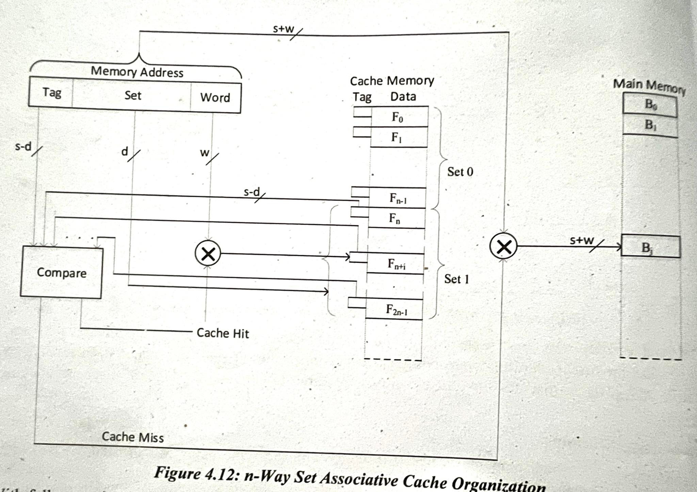
Cache Mapping
Direct mapping

Slide 25
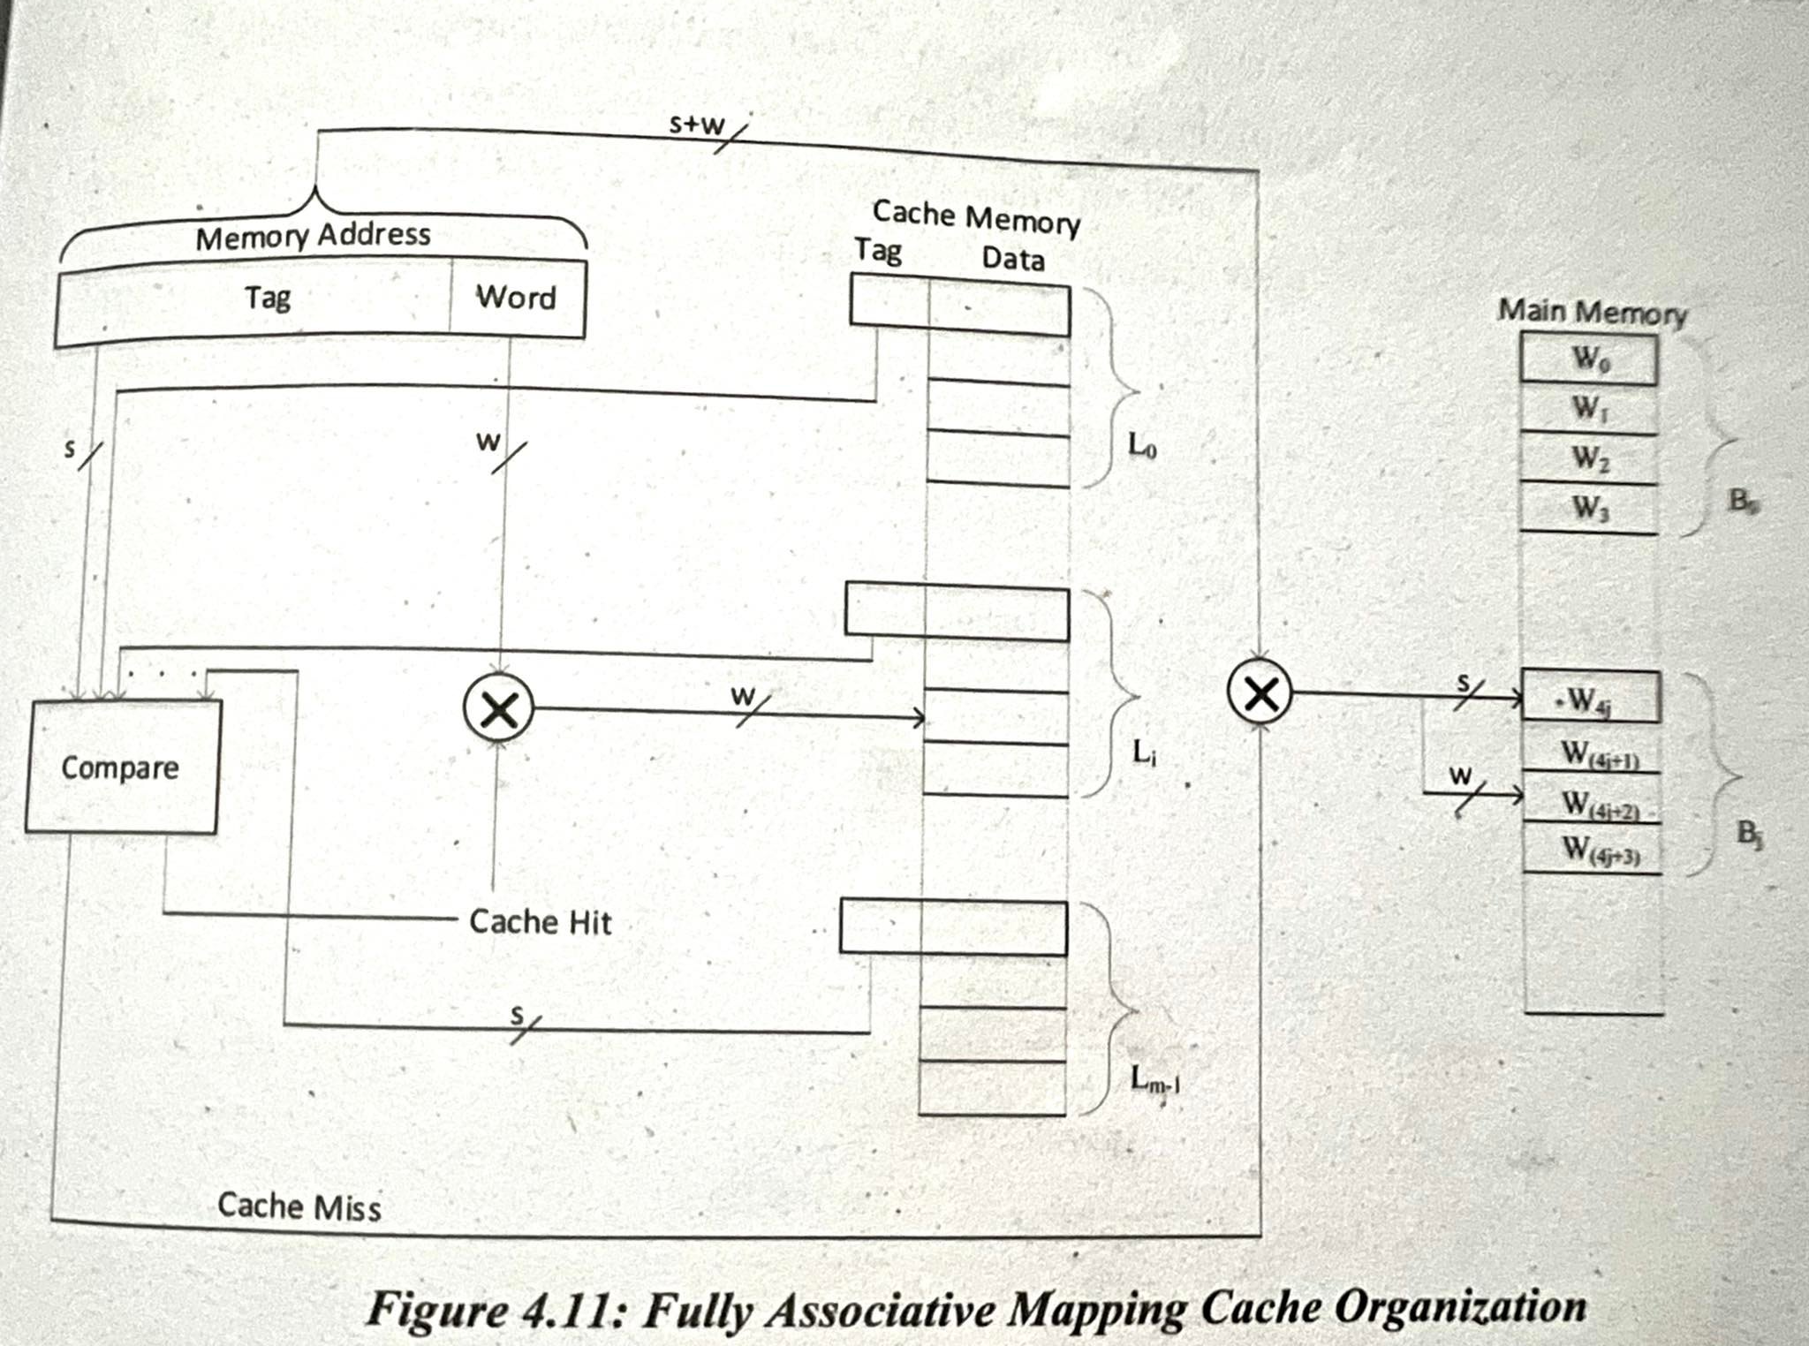
Cache Mapping
Fully Associative mapping

Slide 27
Cache Mapping
Set Associative mapping

Slide 28
Cache-Replacement Policy
When cache is full and new main memory block is to be assigned to the cache then certain technique must be used to choose which cache line should be replaced.
This mechanism of replacing the existing block by new set of blocks is referred as cache-replacement policy. In direct mapping the main memory block always maps to the fixed cache line, so replacement is fixed.
But fully associative and set associative can follow various replacement algorithms.
Least Recently Used (RU), First In First Out (FIFO), Least-Frequently Used (LFU) and Random are few commonly used replacement techniques

Slide 29
Cache-Replacement Policy
Few commonly used replacement techniques.
Random replacement replaces the block randomly without following any specific algorithm.
Least Recently Used (LRU) algorithm is based on time in which the block not accessed for longest time is replaced by the new block.
First In First Out (FIFO) method uses queue mechanism to replace the first entered block. Each block is pushed into the queue when accessed. And when replacement is required the blocks are popped out from the queue.
Least Frequently Used (LFU) technique is based on number of time the block is accessed. The block which is accessed less number of times is replaced.

Slide 30
Cache-Write Policy
A mechanism is required when content of cache is changed by the processor and the change must be updated to the corresponding main memory block.
This technique of updating the main memory after change in cache is referred as cache write policy.
There are two common cache write policy; write-through and write-back.

Slide 31
Cache-Write Policy
Write-through Policy
Write-through is a technique in which the main memory is updated immediately after the content in cache is changed.
This technique is easier to implement but the processor has to wait for slower main memory frequent access. Also there are chances of unnecessary writes resulting in substantial memory traffic.
For example when a particular value is changed four times, the last updated value must only be updated in the main memory. But the memory is updated four times for every change causing unnecessary memory access

Slide 32
Cache-Write Policy
Write-back Policy
Write-back policy allows main memory to be updated only when cache line is to be replaced.
Extra bit is associated with each cache line to represent whether the content of cache line is changed or not.
Based on that extra bit the corresponding main memory block is updated when cache line is about to be replaced.
Extra bit and update checking increase system complexity; however, it reduces number of slow main memory access and avoids memory congestion.

Slide 33
Cache Impact on System Performance
The performance of system is directly related to design and configuration of caches.
The total size of cache, degree of associativity, and the data block size are important parameters that have direct impact on performance.

Slide 34
Cache Impact on System Performance
Cache size
Cache size is the total number of bytes that the cache can store.
The tags and extra bits, which do not contribute to the size of the cache, are also stored in cache along with the data of main memory block.
Increasing the size of cache results in lower miss rates, however the access of data from the cache will be slower. So, larger cache size does not necessarily mean better performance.

Slide 35
Cache Impact on System Performance
Degree of associativity
Degree of associativity is related to number of sets used in set associative cache implementation.
Increasing the number of sets will improve the hit rate. However, additional logic requirement will increase the access time latency.

Slide 36
Cache Impact on System Performance
Cache line size
Cache line size represents the size of each block in cache that holds the block of data of main memory.
When line size is increased, the main memory access time is, obviously, reduced but only at the expense of more complex multiplexing circuitry which increases the access latency.

